Slide 1
CS 725- Foundations of Machine Learning
CREDIT CARD REWARD MAXIMIZATION

Slide 2
Problem Statement:
Credit cards offer various benefits, including cashback, rewards, and discounts. However, not all benefits are useful to every cardholder.
They used to design like this(one cannot maximize the benefits according to his/her profession or lifestyle).
Goal:
Build a model to predict which credit card offers are most likely to be useful for a given cardholder, based on their spending patterns, profession, and lifestyle.

Slide 3
Setup(The Dataset)
I began by preprocessing the dataset, handling missing values, and encoding categorical variables such as the profession and spending category. Feature engineering was performed to create new features like total spending across categories, reward efficiency, and other key spending-related metrics.
After all this the data set adjusted to:
1296675 rows × 24 columns(337MB)-------------------------->7350 rows × 9 columns(624KB)

Slide 4
Models Chosen
Random Forest Regressor:
Ensemble learning model using decision trees
Effective for handling large feature spaces and non-linear relationships
LightGBM:
Gradient boosting framework for faster training and better performance
Suitable for large datasets with a high number of categorical features
XGBoost:
Another gradient boosting framework, known for regularization to reduce overfitting
Focus on efficiency and predictive power

Slide 5
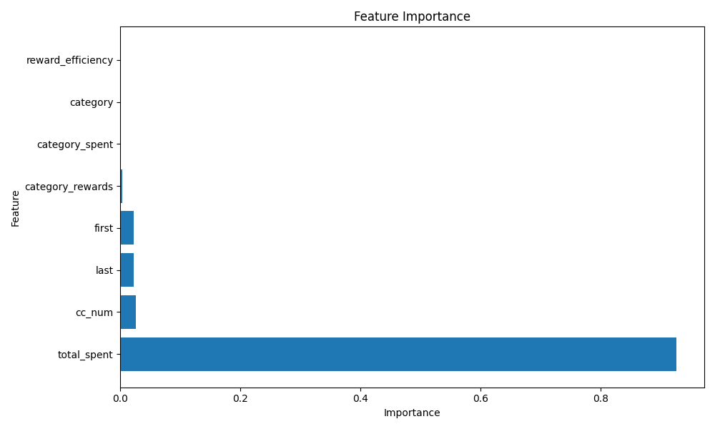
Feature importance scores reveal that "total_spent" has the highest impact on the model'spredictions As higher spending typically leads to more rewards.

Slide 6
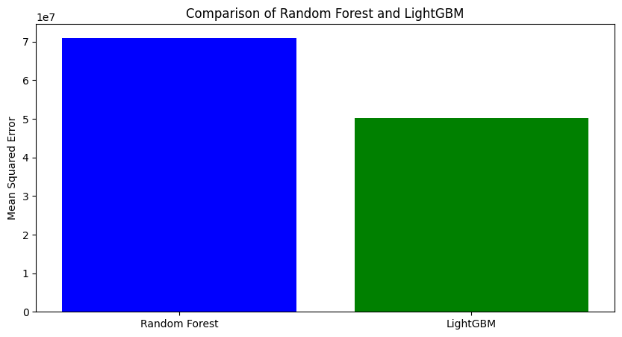
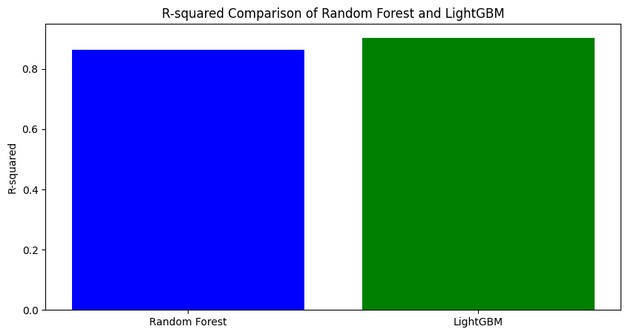
Comparison between Random Forest & LightGBM LightGBM has a lower MSE compared to Random Forest LightGBM has a slightly higher R² than Random Forest

Slide 7
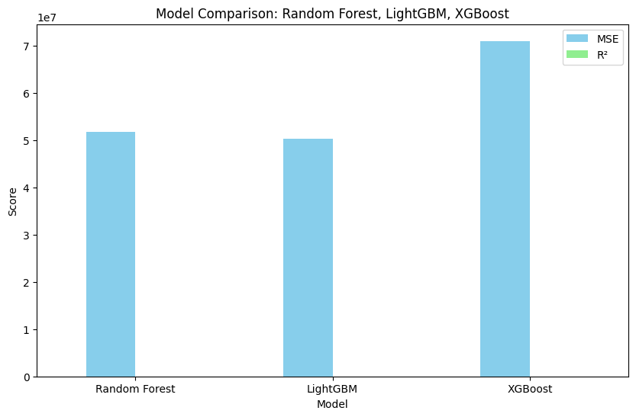
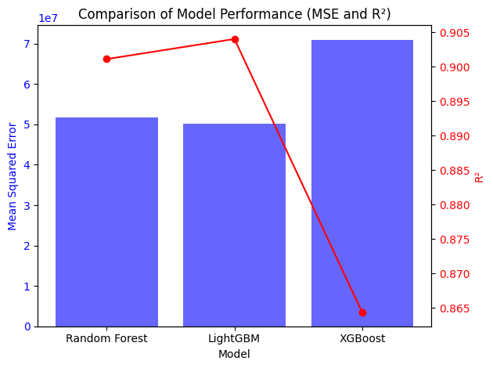
Comparison of Model Performance (MSE and R²)

Slide 8
Results:
Among the three models tested, LightGBM had the lowest Mean Squared Error (MSE) and a high R² value, making it the most reliable model for predicting credit card rewards accurately.
Model | MSE | R-Squared
Random Forest | 51,758,105.59 | 0.9011
LightGBM | 50,233,163.93 | 0.9040
XGBoost | 71,005,714.62 | 0.8643

Slide 9
Conclusion:
The dataset might not fully capture the diversity of user behaviors, potentially introducing bias in the predictions.
The project relies on a limited number of features, which may not fully capture the complexities of credit card reward allocations.
The framework can be scaled to include more features, larger datasets, or even be adapted for other financial applications.
The approach is adaptable to other datasets or business scenarios, allowing for future modifications to cater to different industries or credit card reward schemes.

Slide 10
THANK YOU

